Slide 1
Alaska Photography
By Kodiak West Travel

Slide 2
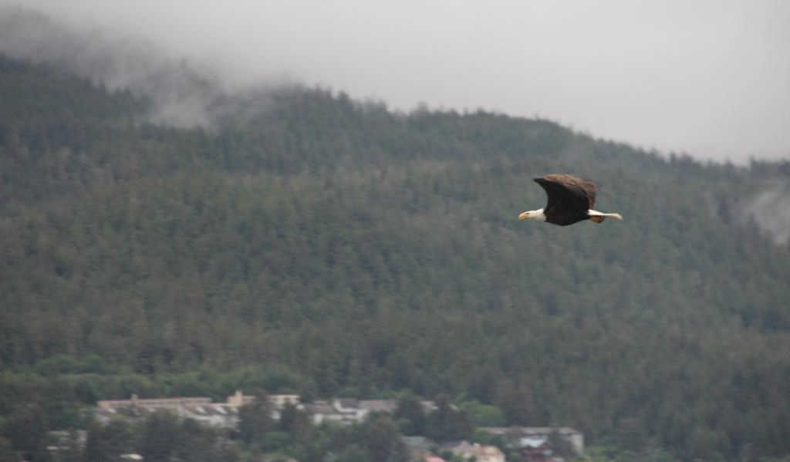
Lights, Camera, Action
Be prepared at all times with your camera. You will want to be ready if nature decides to fly right by you.

Slide 3
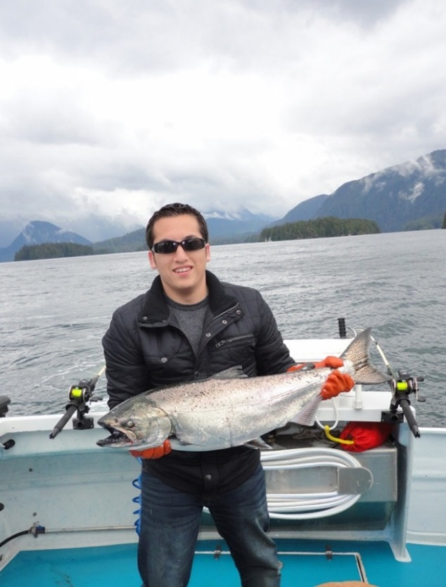
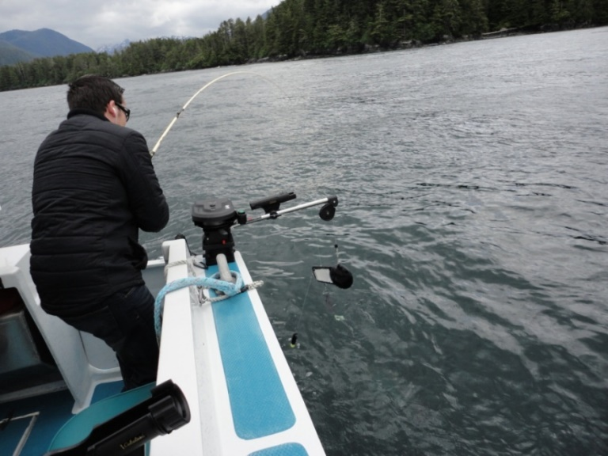
Invest In An Anti-shake Lens For Choppy Water Photography

Slide 4
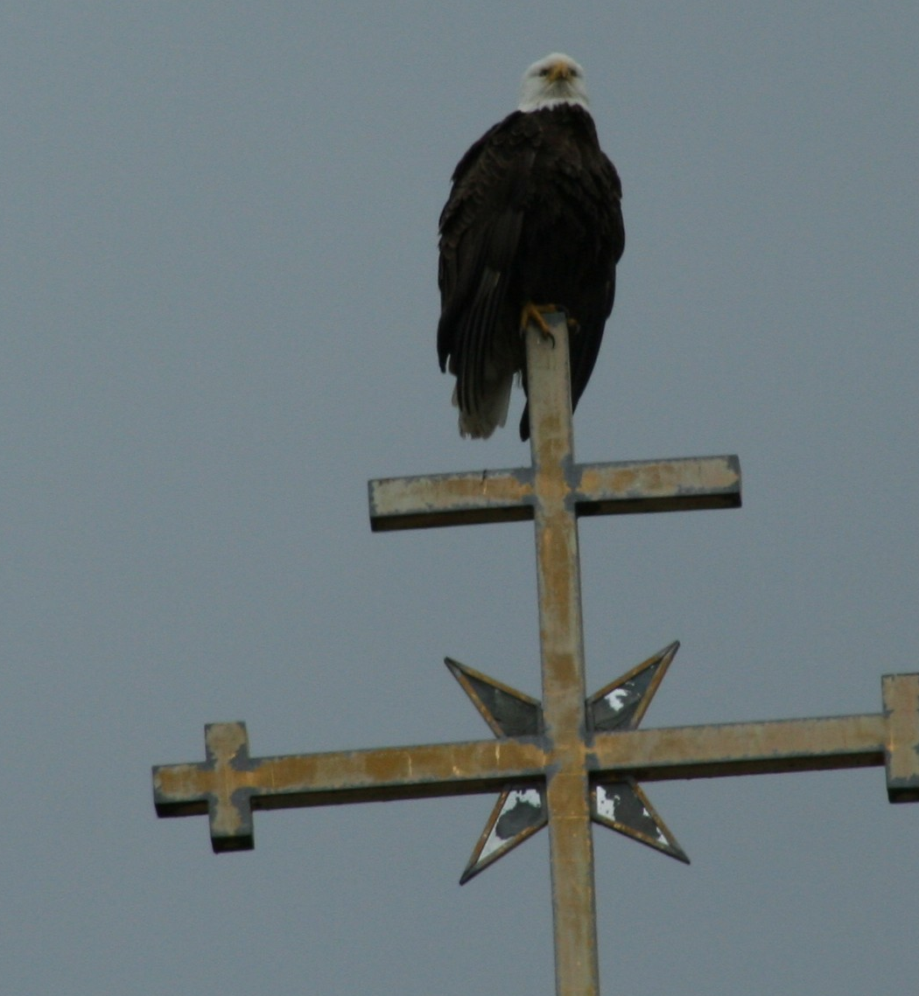
Be aware of the scenery around you. Look in all directions to find the best photographic opportunities.

Slide 5
Get In On The Action
With Deep Sea Fishing

Slide 6
PHOTOGRAPHY TIPS
Dress for the weather—it can be extreme
Choose the right camera gear
Do the research
Be familiar with the lighting
Learn to work fast

